Slide 1
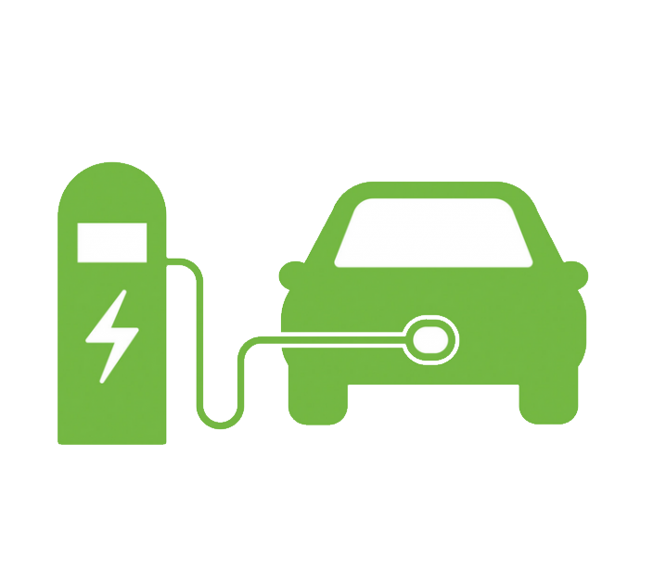
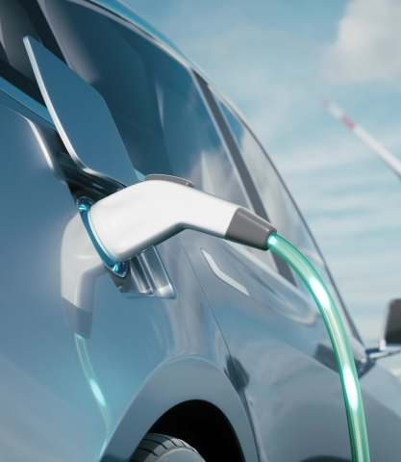

Business Insights on India’s Electric Vehicle Market (FY22-FY24)
AtliQ Motors

Slide 2
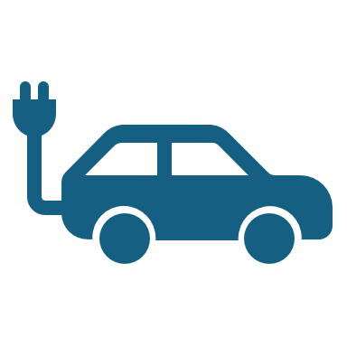
Problem Statements
AtliQ Motors is an automotive giant from the USA specializing in electric vehicles (EV). In the last 5 years, their market share rose to 25% in electric and hybrid vehicles segment in North America. As a part of their expansion plans, they wanted to launch their bestselling models in India where their market share is less than 2%. Bruce Haryali, the chief of AtliQ Motors India wanted to do a detailed market study of existing EV/Hybrid market in India before proceeding further.

Slide 3

Key Performance Indicator

Slide 4
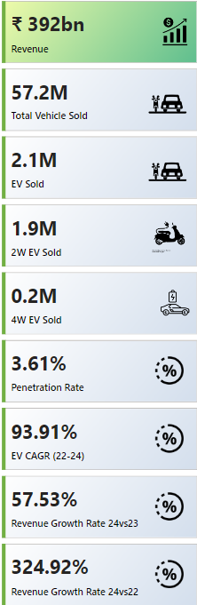
Revenue and Sales:
The total revenue from EV sales in India reached ₹392 billion.
A total of 57.2 million vehicles were sold, out of which 2.1 million were electric vehicles (EVs).
Market Breakdown:
The majority of EVs sold were two-wheelers (2W), with 1.9 million units sold.
Four-wheelers (4W) accounted for 0.2 million units of the total EV sales.
Penetration and Growth:
The penetration rate of EVs in the market was 3.61%.
The EV Compound Annual Growth Rate (CAGR) from 2022 to 2024 was an impressive 93.91%.
The revenue growth rate from 2023 to 2024 was 57.53%, and from 2022 to 2024, the market saw a significant growth of 324.92%.
These figures suggest a rapidly growing EV market in India, with a strong preference for two-wheelers in the EV segment. The high CAGR and growth rates indicate that the adoption of EVs is accelerating, which could be due to increasing consumer awareness, government incentives, and the growing infrastructure for EVs.

Slide 5

Competitor Analysis

Slide 6
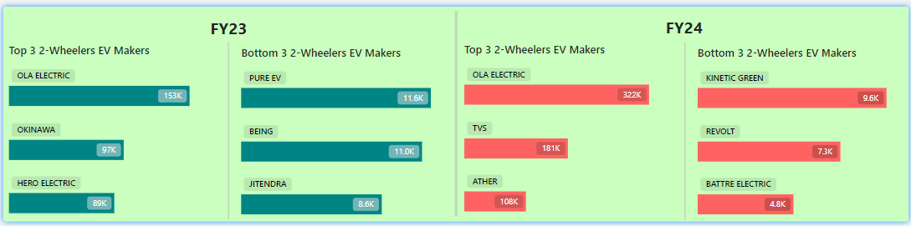
2-Wheeler EV Market Segment
Top Performers in 2-Wheeler EV Market:
Ola Electric is the leading manufacturer with the highest sales volume, followed by Okinawa and Hero Electric In FY23.
In FY24, Ola Electric leads again with TVS and Ather trailing behind.
Bottom Performers in 2-Wheeler EV Market:
The manufacturers with the lowest sales figures are Pure EV, Being, and Jitendra in FY23, and Kinetic Green, Revolt, and Battre in FY24.

Slide 7
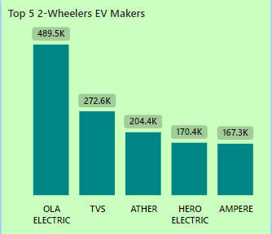
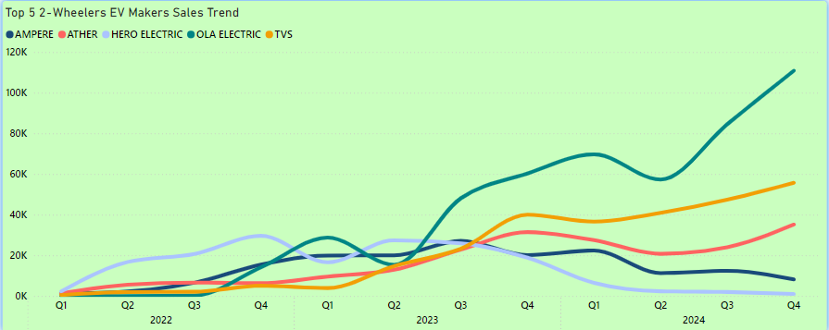
Leading EV Manufacturers:
Ola Electric is the dominant leader, with sales reaching approximately 489.5K units.
TVS follows with 272.6K units, indicating a strong market presence but significantly behind Ola Electric.
Ather and Hero Electric have similar sales volumes, with 204.4K and 170.4K units respectively.
Ampere closes the top 5 list with 167.3K units sold.
Market Distribution:
The data suggests a highly competitive market where the top 5 manufacturers hold a significant share of the two-wheeler EV market in India.
Sales Trends:
The large sales figures for Ola Electric indicate a strong consumer preference or successful market strategy, while the other manufacturers also maintain robust sales, contributing to the overall growth of the EV sector.

Slide 8
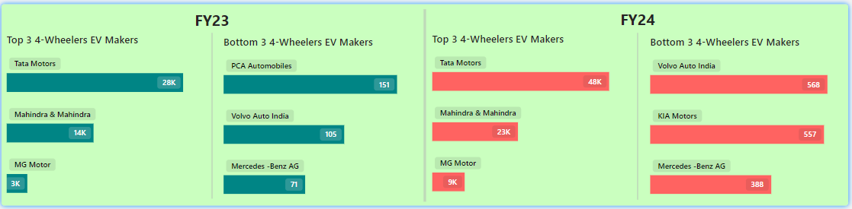
4-Wheeler EV Market Segment
Top 3 Four-Wheeler EV Manufacturers:
Tata Motors leads the market with the highest sales, recording 48K units in FY24, up from 28K in FY23.
Mahindra & Mahindra follows, with sales increasing from 14K units in FY23 to 23K units in FY24.
MG Motor rounds out the top three, with 9K units sold in FY24, compared to 3K units in the previous fiscal year.
Bottom 3 Four-Wheeler EV Manufacturers:
Volvo Auto India, KIA Motors, and Mercedes-Benz AG are among the lowest performers, with sales figures in FY24 at 459, 328, and 291 units, respectively.
A notable decline is observed for PCA Automobiles, Volvo Auto India, and Mercedes-Benz AG with sales as low as 151, 105, and 71 units respectively in FY23.
Sales Growth Trends:
The top manufacturers, particularly Tata Motors, have shown significant year-on-year growth, suggesting a strong demand and effective market strategies.
In contrast, the bottom manufacturers have struggled to gain a substantial market share, reflecting either limited product offerings or weaker brand presence in the EV market.
These insights reflect a clear market hierarchy, with a few dominant players driving the growth in the four-wheeler EV segment in India, while others lag behind significantly.

Slide 9
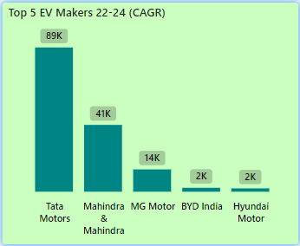
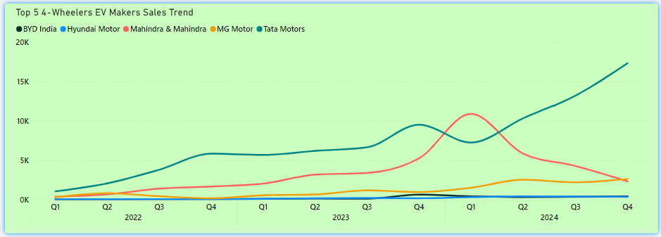
Leading Manufacturers:
Tata Motors is the top performer with 89K units sold, significantly ahead of its competitors.
Mahindra & Mahindra follows with 41K units, holding a strong second position.
MG Motor is in third place with 14K units sold.
Emerging Players:
BYD India and Hyundai Motor are tied, each selling 2K units, indicating their growing presence in the Indian EV market but still far behind the leaders.
Market Concentration:
The market is highly concentrated, with Tata Motors dominating, followed by Mahindra & Mahindra, while the remaining manufacturers have relatively small sales volumes.
These insights highlight the dominance of Tata Motors in the four-wheeler EV market in India, with Mahindra & Mahindra also showing strong performance. Other manufacturers like MG Motor, BYD India, and Hyundai Motor are still building their market presence.

Slide 10
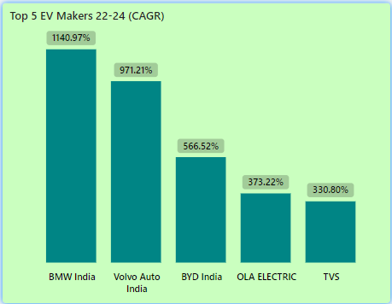
Compound Annual Growth Rate
Rapid Growth Leaders:
BMW India exhibits the highest CAGR at 1140.97%, indicating a massive expansion in their EV sales over this period.
Volvo Auto India follows closely with a CAGR of 971.21%, reflecting a significant increase in their market presence.
Strong Performers:
BYD India also shows a substantial CAGR of 566.52%, demonstrating robust growth in the Indian market.
OLA ELECTRIC and TVS round out the top five with CAGRs of 373.22% and 330.80% respectively, indicating strong but slightly more moderate growth compared to the top three.
Market Implications:
The exceptionally high CAGRs for BMW India and Volvo Auto India suggest these companies are aggressively expanding their EV offerings and capturing a growing share of the market.
The presence of both established automotive brands and newer players like OLA Electric and BYD India in this list indicates a dynamic and rapidly evolving market landscape.
These insights highlight the rapid growth and competitiveness within the Indian EV market, with both luxury and mainstream brands making significant strides in EV adoption.

Slide 11

State-wise Analysis

Slide 12
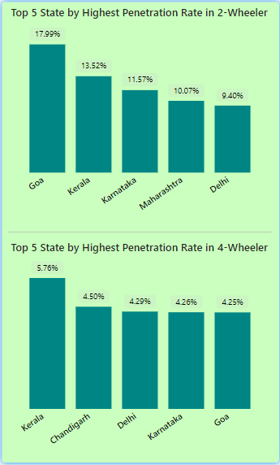
Penetration Rate in FY24
1. 2-Wheeler Penetration Rate:
Goa has the highest penetration rate for 2-wheelers at 17.99%, making it the leader in this category.
Kerala follows with a penetration rate of 13.52%, indicating a strong presence of 2-wheelers in the state.
Karnataka comes in third at 11.57%.
Maharashtra has a penetration rate of 10.07%.
Delhi rounds out the top five with a penetration rate of 9.40%.
2. 4-Wheeler Penetration Rate:
Kerala also leads in the 4-wheeler category with a penetration rate of 5.76%.
Chandigarh is second with 4.50%.
Delhi has a penetration rate of 4.29%, placing it third.
Karnataka is close behind with a penetration rate of 4.26%.
Goa also features in the top five for 4-wheelers, with a penetration rate of 4.25%.
Key Takeaways:
Goa and Kerala show strong market penetration for both 2-wheelers and 4-wheelers.
Delhi and Karnataka also feature prominently in both categories, suggesting balanced growth across different vehicle types.

Slide 13
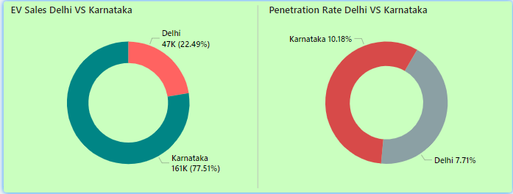
Comparison Between Delhi & Karnataka in FY24
Insights:
EV Sales:
Karnataka: Leads in EV sales with 161K units, representing 77.51% of the total sales.
Delhi: Accounts for 47K units, which is 22.49% of the total EV sales.
Conclusion: Karnataka has a significantly higher number of EV sales compared to Delhi, with more than three times the sales volume.
Penetration Rate:
Karnataka: Also has a higher EV penetration rate of 10.18%.
Delhi: Has a lower penetration rate of 7.71%.
Conclusion: Karnataka not only leads in absolute EV sales but also has a higher EV penetration rate compared to Delhi. This indicates that EVs form a larger proportion of the total vehicle market in Karnataka than in Delhi.
The data suggests that Karnataka is both ahead in total EV sales and more successful in integrating EVs into its overall vehicle market.

Slide 14
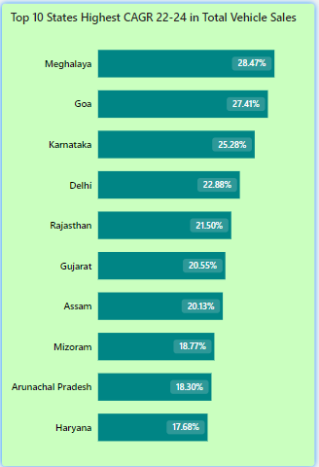
Compound Annual Growth Rate
Insights:
Northeastern states like Meghalaya, Assam, and Mizoram are seeing significant growth in vehicle sales, indicating increasing economic activity and mobility in these regions.
Goa and Karnataka also show impressive growth, which could be driven by tourism and urbanization, respectively.
Delhi and Rajasthan continue to see strong growth, which might be driven by urban expansion and economic development.
Haryana, while still in the top 10, shows the lowest CAGR among the listed states, indicating slower growth compared to the others.
Overall, these states are leading the way in vehicle market growth, with Meghalaya and Goa showing exceptional increases.

Slide 15
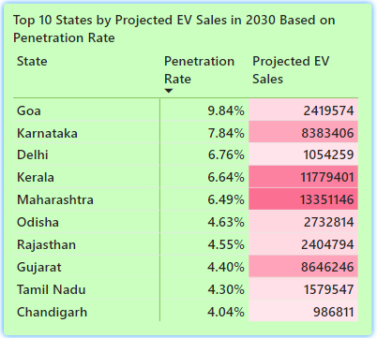
Projected EV Sales in 2030
Insights:
Maharashtra, Kerala, and Gujarat are set to lead in absolute EV sales due to their large market sizes.
Goa has the highest penetration rate, while Delhi and Karnataka show strong adoption potential.
The data highlights varying levels of EV market maturity across states, with larger states dominating in sales volume, and smaller states like Goa excelling in penetration rates.

Slide 16
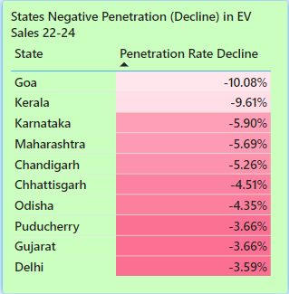
Negative Penetration
Insights:
Goa and Kerala have the steepest declines, indicating challenges in sustaining EV adoption.
Maharashtra and Karnataka show notable declines, suggesting potential shifts in market dynamics.
Delhi and Gujarat have smaller declines, indicating less severe market impact.
These trends may reflect market saturation, economic factors, policy changes, or increased competition affecting EV sales in these regions.

Slide 17

Seasonal Sales Analysis

Slide 18
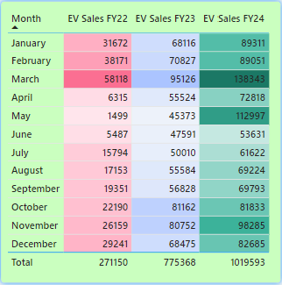
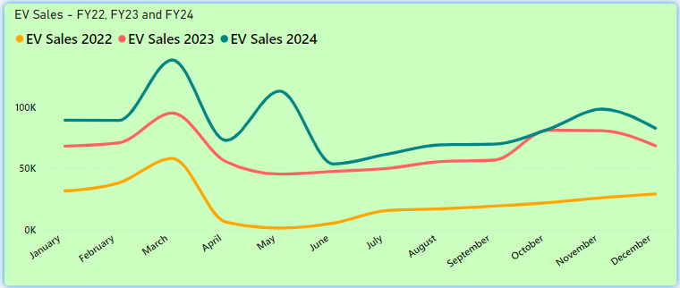
Sales Trend
Insights:
There is a significant increase in EV sales over the three fiscal years. The total sales increased from 271,150 in FY22 to 775,368 in FY23, and further to 1,019,593 in FY24.
There seems to be a surge in EV sales during the last quarter of the fiscal year. These months have some of the highest sales figures, indicating a potential seasonal demand or end-of-year push.
May stands out as the month with the most significant increase in sales from FY23 to FY24, growing from 45,373 to 112,997 and March also shows a large increase in sales year-over-year.
Months like October and November show more stability, with less dramatic year-over-year changes in sales compared to other months.
The total sales have increased from FY22 to FY24, indicating a robust and accelerating growth in the adoption of EVs.
These insights suggest a rapidly growing market for electric vehicles, with particularly strong demand in the later months of the fiscal year.

Slide 19

Revenue Analysis

Slide 20
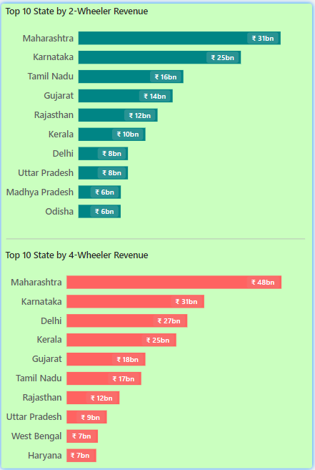

State-Wise Revenue
Insights:
Maharashtra Leads in Both Segments:
Maharashtra is the leading state in revenue generation for both 2-Wheelers and 4-Wheelers, with ₹31 billion from 2-Wheelers and ₹48 billion from 4-Wheelers.
Karnataka is a Strong Contender:
Karnataka ranks second in both categories, generating ₹25 billion from 2-Wheelers and ₹31 billion from 4-Wheelers.
Revenue Disparity Between Vehicle Types:
The revenue from 4-Wheelers tends to be higher than that from 2-Wheelers across most states, indicating a higher price point or greater market volume for 4-Wheelers in these regions.
Top Performers:
Other states consistently appearing in the top ranks include Tamil Nadu, Gujarat, Kerala, and Uttar Pradesh. Each of these states shows significant contributions to both vehicle segments, though with varying rank positions.
Delhi's High 4-Wheeler Revenue:
Delhi stands out for its high revenue from 4-Wheelers (₹27 billion), ranking third, while it does not appear in the top three for 2-Wheelers.
Diversity in Regional Performance:
Some states, like West Bengal and Haryana, appear in the top 10 for 4-Wheelers but not for 2-Wheelers, reflecting regional preferences or market dynamics.
Comparative Analysis:
The data suggests a significant regional preference for different types of vehicles, with urbanized or economically stronger states showing higher revenues, especially in the 4-Wheeler segment.

Slide 21
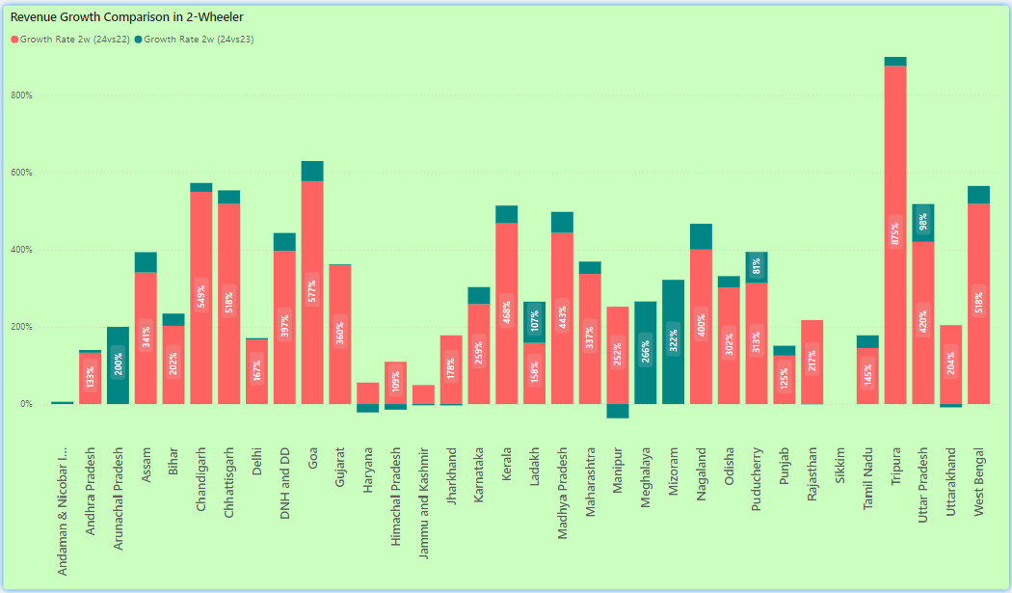
State-Wise Revenue Growth

Slide 22
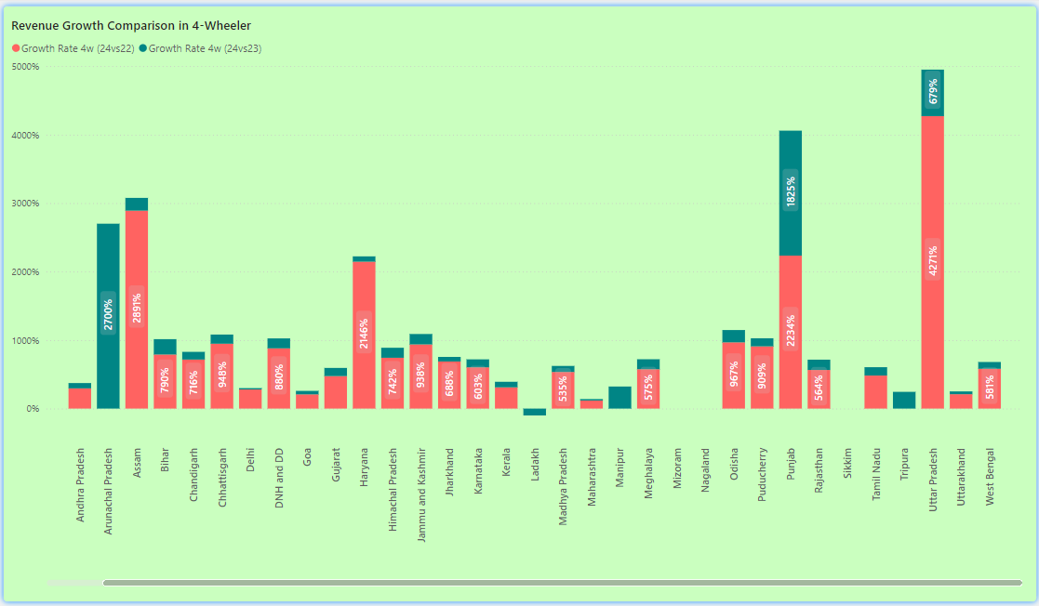

Slide 23

Secondary Research and Analysis

Slide 24
1. Primary Reasons for Choosing 4-Wheeler EVs:
Cost Savings: The total cost of ownership for EVs is often lower than for traditional vehicles due to savings on fuel and maintenance. As battery technology improves and economies of scale are realized, the upfront costs of EVs are decreasing, making them more attractive.
Environmental Concerns: Consumers are becoming more environmentally conscious, preferring vehicles that reduce their carbon footprint. The reduction in emissions is a key factor driving the shift towards EVs.
Government Incentives: Subsidies, tax breaks, and rebates on EV purchases are significant motivators. These incentives reduce the effective cost of EVs, making them more competitive with traditional vehicles.
2. Impact of Government Incentives and Subsidies:
Adoption Rates: Government incentives have a direct impact on adoption rates. In states where subsidies are higher, EV adoption rates are also higher. For instance, Delhi offers substantial subsidies for both 2-wheelers and 4-wheelers, leading to higher sales in these segments.
States: Maharashtra, Delhi, Karnataka, and Tamil Nadu are some of the states providing significant subsidies. Delhi, in particular, has a robust policy framework that includes waiving registration fees, road taxes, and
providing direct purchase subsidies.

Slide 25
3. Correlation Between Charging Infrastructure and EV Sales:
States: States like Maharashtra, Karnataka, Tamil Nadu, Delhi, and Gujarat have a higher number of charging stations, which correlates with higher EV sales and penetration rates. A robust charging infrastructure alleviates range anxiety and makes EVs a more practical option for consumers, directly influencing sales.
Correlation: The availability of charging stations is a critical factor in the decision to purchase an EV. States with well-developed infrastructure see higher EV adoption rates.
4. Brand Ambassador for AtliQ Motors:
Recommendation: A prominent figure known for environmental advocacy and a clean lifestyle, such as Akshay Kumar or Virat Kohli, would be ideal. Both have a strong public image and appeal across a wide demographic, aligning well with the eco-friendly messaging of EVs.
Rationale: The choice of a brand ambassador should reflect the values of sustainability, reliability, and modernity, which are central to the EV brand's identity.

Slide 26
5. Ideal State for Manufacturing Unit:
Maharashtra: Offers a balance of incentives, including subsidies, ease of doing business, and a stable political environment. It also has a well-established automotive manufacturing ecosystem.
Gujarat: Known for its industry-friendly policies, Gujarat offers substantial subsidies and has a streamlined process for setting up manufacturing units. It is also home to several large automotive and EV manufacturers.
Tamil Nadu: Another strong candidate due to its established auto industry and government incentives for EV manufacturing.
6. Top 3 Recommendations for AtliQ Motors:
Focus on Charging Infrastructure: Partner with local governments and private players to expand the charging network in key states, which will drive EV adoption.
Leverage Government Incentives: Capitalize on available subsidies by aligning product launches and pricing strategies with states offering the most benefits.
Strategic Marketing and Brand Positioning: Use targeted marketing campaigns that highlight cost savings, environmental benefits, and government incentives to appeal to the primary motivations of EV buyers.

